Slide 1
Computer Organization
Part 03: Von-Neumann Computer Architecture

Slide 2


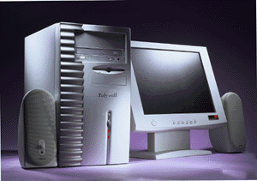
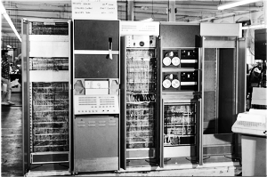
Designing Computers
All computers more or less based on the same basic design, the Von Neumann Architecture!

Slide 3
The Von Neumann Architecture
Model for designing and building computers, based on the following three characteristics:
  The computer consists of four main sub-systems:
    Memory
    ALU (Arithmetic/Logic Unit)
    Control Unit
    Input/Output System (I/O)
  Program is stored in memory during execution.
  Program instructions are executed sequentially.

Slide 4
The Von Neumann Architecture
Bus
Memory
Processor (CPU)
Input-Output
Control Unit
ALU
Communicate with
"outside world", e.g.
Screen
Keyboard
Storage devices
...
Store data and program
Execute program
Do arithmetic/logic operations
requested by program

Slide 5
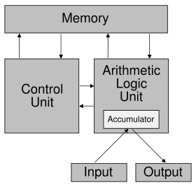
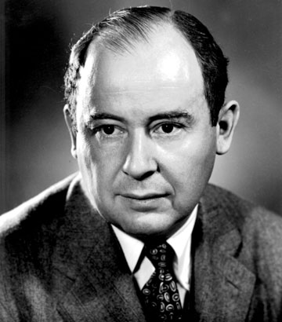
Simplified Architecture
Source: Wikipedia

Slide 6


Slide 7
Memory Subsystem
Memory, also called RAM (Random Access Memory),
  Consists of many memory cells (storage units) of a fixed size.
  Each cell has an address associated with it: 0, 1, …
  All accesses to memory are to a specified address.
  A cell is the minimum unit of access (fetch/store a complete cell).
  The time it takes to fetch/store a cell is the same for all cells.
When the computer is running, both
  Program
  Data (variables)
are stored in the memory.

Slide 8
RAM
N
Need to distinguish between
  the address of a memory cell and the content of a memory cell
Memory width (W):
  How many bits is each memory cell, typically one byte (=8 bits)
Address width (N):
  How many bits used to represent each address, determines the maximum memory size = address space
  If address width is N-bits, then address space is 2^{N} (0,1,...,2^{N}-1)
0000000000000001
1 bit
0
1
2
...
2^{N}
2^{N}-1
W

Slide 9
Memory Size / Speed
Typical memory in a personal computer (PC):
  64MB - 256MB
Memory sizes:
  Kilobyte (KB) = 2¹⁰ = 1,024 bytes ~ 1 thousand
  Megabyte(MB) = 2²⁰ = 1,048,576 bytes ~ 1 million
  Gigabyte (GB) = 2³⁰ = 1,073,741,824 bytes ~ 1 billion
Memory Access Time (read from/ write to memory)
  50-75 nanoseconds (1 nsec. = 0.000000001 sec.)
RAM is
  volatile (can only store when power is on)
  relatively expensive

Slide 10
Operations on Memory
Fetch (address):
  Fetch a copy of the content of memory cell with the specified address.
  Non-destructive, copies value in memory cell.
Store (address, value):
  Store the specified value into the memory cell specified by address.
  Destructive, overwrites the previous value of the memory cell.
The memory system is interfaced via:
  Memory Address Register (MAR)
  Memory Data Register (MDR)
  Fetch/Store signal

Slide 11
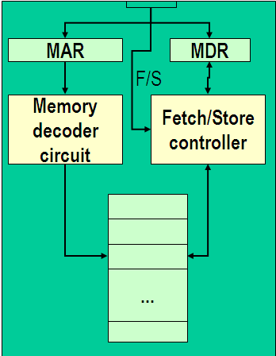
Structure of the Memory Subsystem
Fetch(address)
  Load address into MAR.
  Decode the address in MAR.
  Copy the content of memory cell with specified address into MDR.
Store(address, value)
  Load the address into MAR.
  Load the value into MDR.
  Decode the address in MAR
  Copy the content of MDR into memory cell with the specified address.

Slide 12
Input/Output Subsystem
Handles devices that allow the computer system to:
  Communicate and interact with the outside world
    Screen, keyboard, printer, ...
  Store information (mass-storage)
    Hard-drives, floppies, CD, tapes, …
Mass-Storage Device Access Methods:
  Direct Access Storage Devices (DASDs)
    Hard-drives, floppy-disks, CD-ROMs, ...
  Sequential Access Storage Devices (SASDs)
    Tapes (for example, used as backup devices)

Slide 13
I/O Controllers
Speed of I/O devices is slow compared to RAM
  RAM ~ 50 nsec.
  Hard-Drive ~ 10msec. = (10,000,000 nsec)
Solution:
  I/O Controller, a special purpose processor:
    Has a small memory buffer, and a control logic to control I/O device (e.g. move disk arm).
    Sends an interrupt signal to CPU when done read/write.
  Data transferred between RAM and memory buffer.
  Processor free to do something else while I/O controller reads/writes data from/to device into I/O buffer.

Slide 14
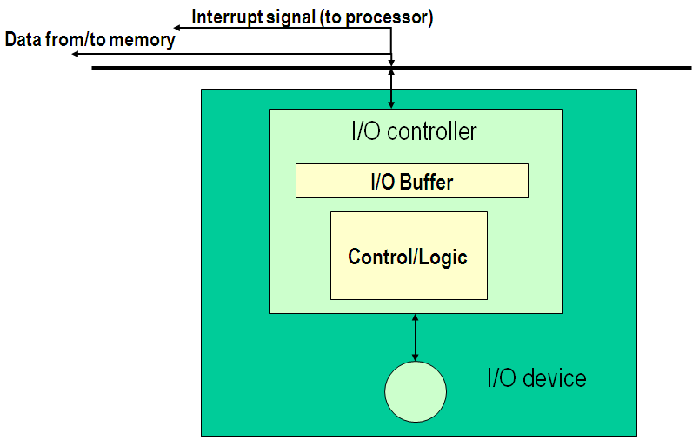
Structure of the I/O Subsystem

Slide 15
The ALU Subsystem
The ALU (Arithmetic/Logic Unit) performs
  mathematical operations (+, -, x, /, …)
  logic operations (=, <, >, and, or, not, ...)
In today's computers integrated into the CPU
Consists of:
  Circuits to do the arithmetic/logic operations.
  Registers (fast storage units) to store intermediate computational results.
  Bus that connects the two.

Slide 16
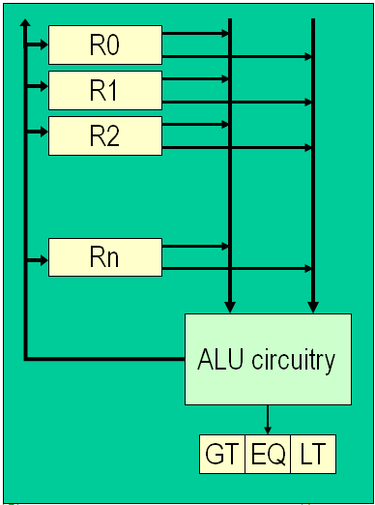
Structure of the ALU
Registers:
  Very fast local memory cells, that store operands of operations and intermediate results.
  CCR (condition code register), a special purpose register that stores the result of <, = , > operations
ALU circuitry:
  Contains an array of circuits to do mathematical/logic operations.
Bus:
  Data path interconnecting the registers to the ALU circuitry.

Slide 17
The Control Unit
Program is stored in memory
  as machine language instructions, in binary
The task of the control unit is to execute programs by repeatedly:
  Fetch from memory the next instruction to be executed.
  Decode it, that is, determine what is to be done.
  Execute it by issuing the appropriate signals to the ALU, memory, and I/O subsystems.
  Continues until the HALT instruction

Slide 18
Machine Language Instructions
A machine language instruction consists of:
  Operation code, telling which operation to perform
  Address field(s), telling the memory addresses of the values on which the operation works.
Example: ADD X, Y (Add content of memory locations X and Y, and store back in memory location Y).
Assume: opcode for ADD is 9, and addresses X=99, Y=100
Opcode (8 bits)
Address 1 (16 bits)
Address 2 (16 bits)
00001001
0000000001100011
0000000001100100

Slide 19
Instruction Set Design
Two different approaches:
  Reduced Instruction Set Computers (RISC)
    Instruction set as small and simple as possible.
    Minimizes amount of circuitry --> faster computers
  Complex Instruction Set Computers (CISC)
    More instructions, many very complex
    Each instruction can do more work, but require more circuitry.

Slide 20
Typical Machine Instructions
Notation:
  We use X, Y, Z to denote RAM cells
  Assume only one register R (for simplicity)
  Use English-like descriptions (should be binary)
Data Transfer Instructions
  LOAD X Load content of memory location X to R
  STORE X Load content of R to memory location X
  MOVE X, Y Copy content of memory location X to loc. Y
  (not absolutely necessary)

Slide 21
Machine Instructions (cont.)
Arithmetic
  ADD X, Y, Z CON(Z) = CON(X) + CON(Y)
  ADD X, Y CON(Y) = CON(X) + CON(Y)
  ADD X R = CON(X) + R
  similar instructions for other operators, e.g. SUBTR,OR, ...
Compare
  COMPARE X, Y
  Compare the content of memory cell X to the content of memory cell Y and set the condition codes (CCR) accordingly.
  E.g. If CON(X) = R then set EQ=1, GT=0, LT=0

Slide 22
Machine Instructions (cont.)
Branch
  JUMP X Load next instruction from memory loc. X
  JUMPGT X Load next instruction from memory loc. X only if GT flag in CCR is set, otherwise load statement from next sequence loc. as usual.
    JUMPEQ, JUMPLT, JUMPGE, JUMPLE,JUMPNEQ
Control
  HALT Stop program execution.

Slide 23
Example
Pseudo-code: Set A to B + C
Assuming variable:
  A stored in memory cell 100, B stored in memory cell 150, C stored in memory cell 151
Machine language (really in binary)
  LOAD 150
  ADD 151
  STORE 100
  or
  (ADD 150, 151, 100)

Slide 24
Structure of the Control Unit
PC (Program Counter):
  stores the address of next instruction to fetch
IR (Instruction Register):
  stores the instruction fetched from memory
Instruction Decoder:
  Decodes instruction and activates necessary circuitry
PC
IR
+1
Instruction
Decoder

Slide 25
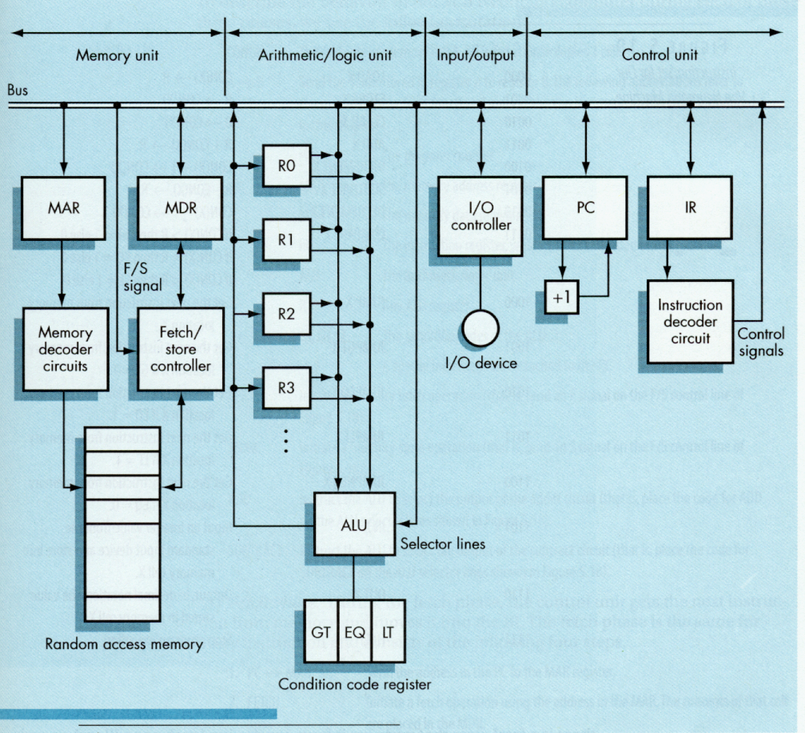
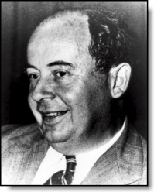
von Neumann
Architecture

Slide 26
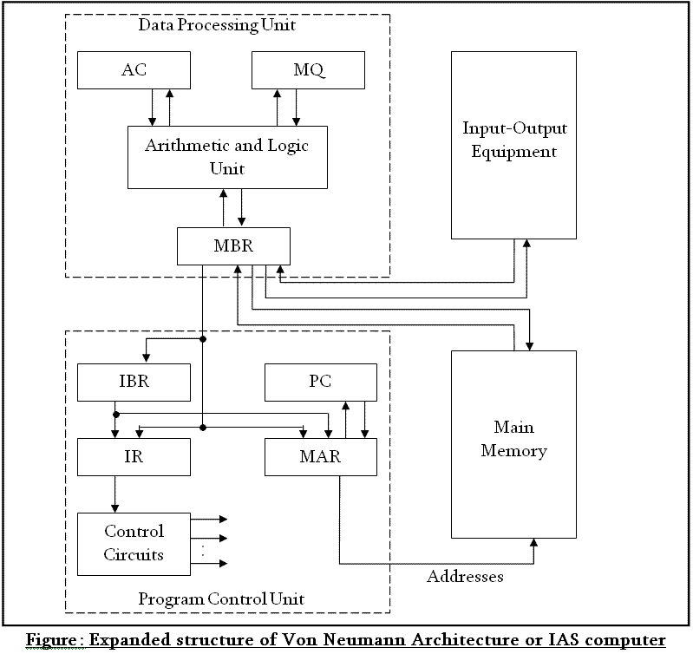

Slide 27

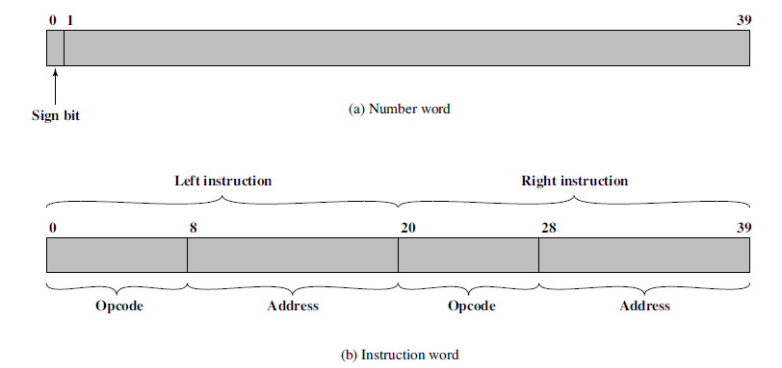
IAS Memory Formats

Slide 28
How does this all work together?
Program Execution:
  PC is set to the address where the first program instruction is stored in memory.
  Repeat until HALT instruction or fatal error
Fetch instruction
Decode instruction
Execute instruction
End of loop

Slide 29
Program Execution (cont.)
Fetch phase
  PC --> MAR (put address in PC into MAR)
  Fetch signal (signal memory to fetch value into MDR)
  MDR --> IR (move value to Instruction Register)
  PC + 1 --> PC (Increase address in program counter)
Decode Phase
  IR -> Instruction decoder (decode instruction in IR)
  Instruction decoder will then generate the signals to activate the circuitry to carry out the instruction

Slide 30
Program Execution (cont.)
Execute Phase
  Differs from one instruction to the next.
Example:
  LOAD X (load value in addr. X into register)
    IR_address -> MAR
    Fetch signal
    MDR --> R
  ADD X
    left as an exercise
Notes:
CMPUT101 Introduction to Computing - Spring 2001
Chapter 5 The Von Neumann Architecture

Slide 31
Instruction Set for Our Von Neumann Machine
Opcode | Operation | Meaning
0000 | LOAD X | CON(X) --> R
0001 | STORE X | R --> CON(X)
0010 | CLEAR X | 0 --> CON(X)
0011 | ADD X | R + CON(X) --> R
0100 | INCREMENT X | CON(X) + 1 --> CON(X)
0101 | SUBTRACT X | R - CON(X) --> R
0101 | DECREMENT X | CON(X) - 1 --> CON(X)
0111 | COMPARE X | If CON(X) > R then GT = 1 else 0 If CON(X) = R then EQ = 1 else 0 If CON(X) < R then LT = 1 else 0
1000 | JUMP X | Get next instruction from memory location X
1001 | JUMPGT X | Get next instruction from memory loc. X if GT=1
... | JUMPxx X | xx = LT / EQ / NEQ
1101 | IN X | Input an integer value and store in X
1110 | OUT X | Output, in decimal notation, content of mem. loc. X
1111 | HALT | Stop program execution
Notes:
CMPUT101 Introduction to Computing - Spring 2001
Chapter 5 The Von Neumann Architecture

